Slide 1
Pulmonary hypertension Part 2
Dr. Jithin S Panicker
SR Cardiology
CHAIR-DR.RAJESH G
DATE-7/2/23

Slide 2
References
Braunwald's Heart Disease: A Textbook of Cardiovascular Medicine 12th edition
Fuster and Hurst's The Heart, 15th Edition
Moss & Adams Heart Disease in infants Children and Adolescents 10th Edition
2022 ESC/ERS Guidelines for the diagnosis and treatment of pulmonary hypertension
Interventional and Surgical Treatments for Pulmonary Arterial Hypertension. J. Clin. Med. 2021
Advances in Therapeutic Interventions for Patients With Pulmonary Arterial Hypertension: Circulation 2014
Echocardiographic assessment of pulmonary hypertension: standard operating procedure Eur Respir Rev 2012
Radiopedia.org
Right heart catheterization: best practice and pitfalls in pulmonary hypertension European Resp. Review 2016
Textbook of Clinical Echocardiography Catherine M. Otto
Pulmonary Arterial Hypertension N Engl J Med 2021; 385:2361-2376
Grossman & Baim's Cardiac Catheterization, Angiography, and Intervention 8th edition

Slide 3
Outline
Establish the diagnosis of PH
Management of PH

Slide 4
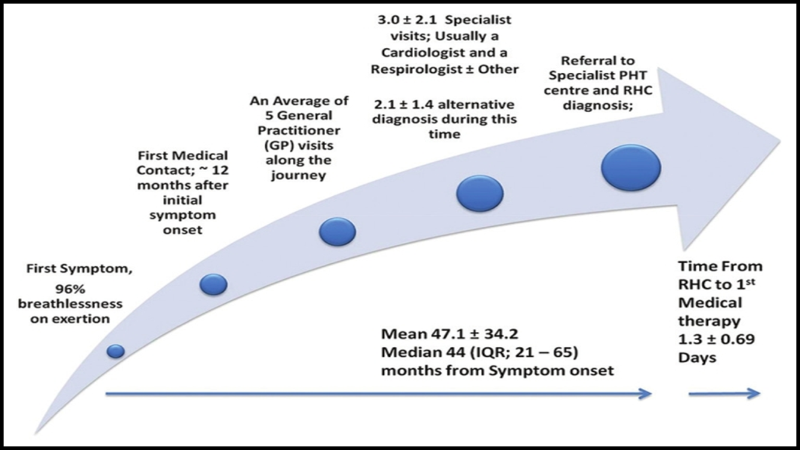
Delay in Recognition of Pulmonary Arterial Hypertension
1 in 5 patients
REVEAL Registry who were diagnosed with PAH
Symptoms for > 2 years before
Brown LM, Chen H, Halpern S, Taichman D, McGoon MD, Farber HW, Frost AE, Liou TG, Turner M, Feldkircher K, Miller DP, Elliott CG. Delay in recognition of pulmonary arterial hypertension: factors identified from the REVEAL Registry. Chest. 2011 Jul;140(1):19-26.

Slide 5
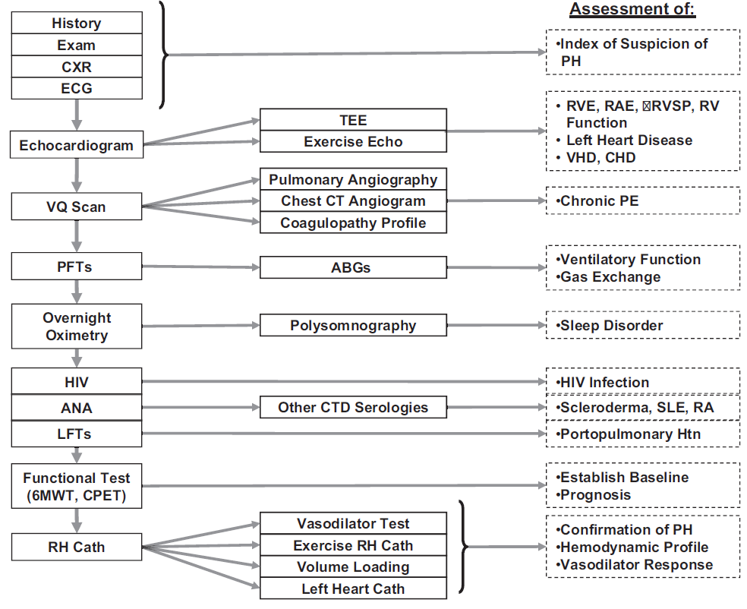

Slide 6
1. ECG

Slide 7
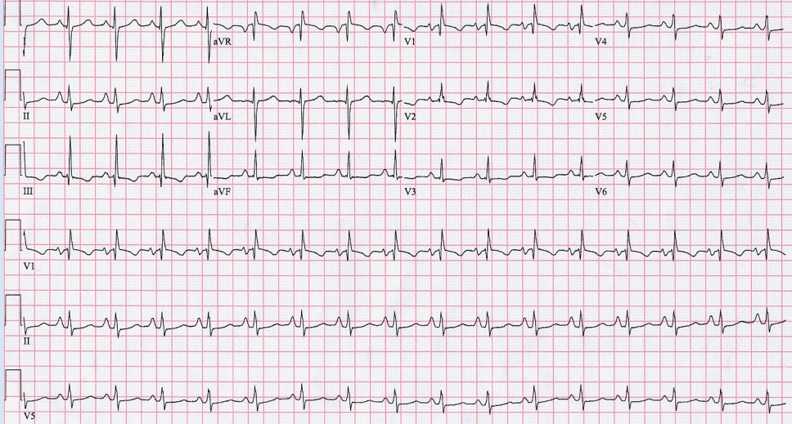
Notes:
P pulmonale, Right axis deviation, R/S > 1, RV strain

Slide 8
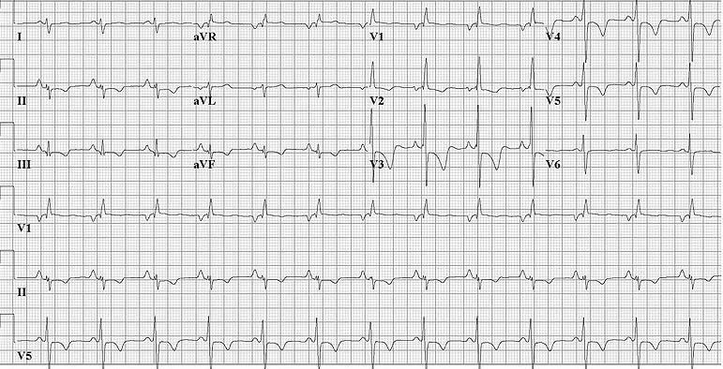

Slide 9
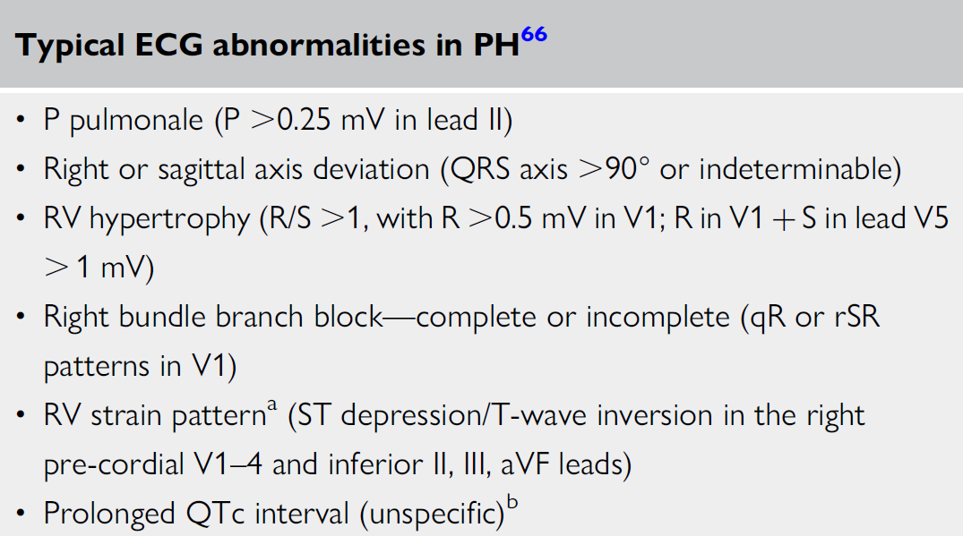

Slide 10
2. CXR

Slide 11
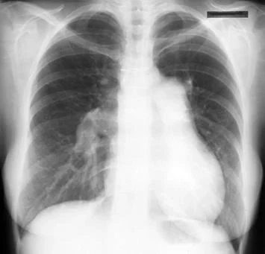
Enlarged pulmonary arteries
Notes:
ASD

Slide 12
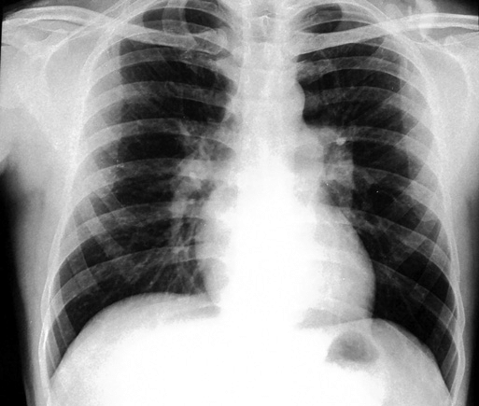
prominent central pulmonary artery with peripheral pruning

Slide 13
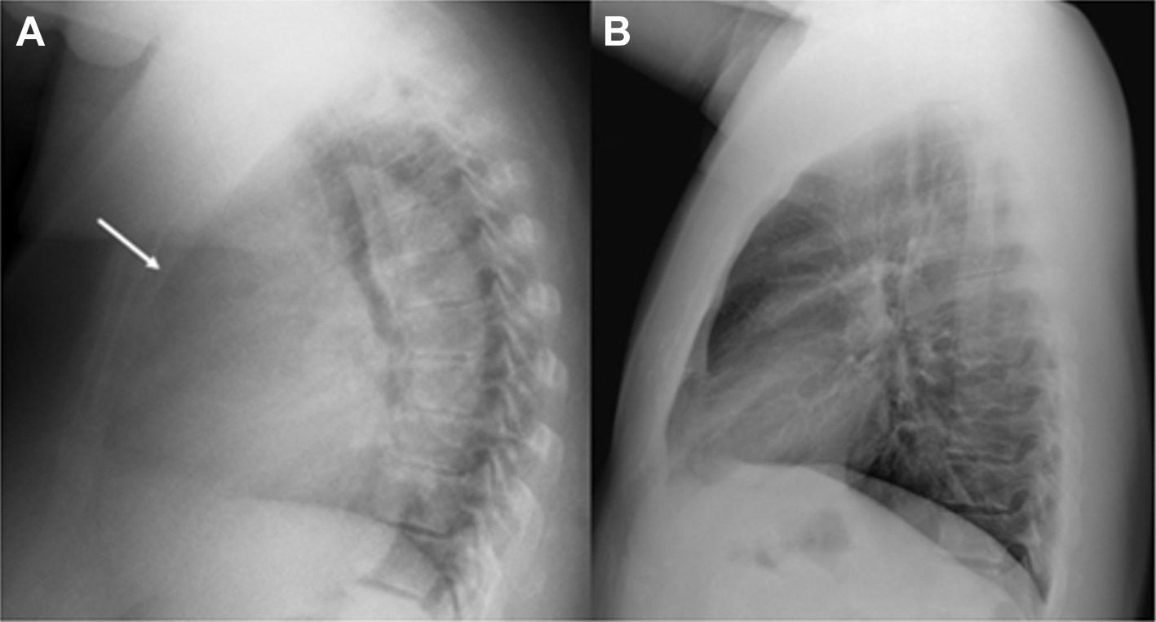
Fullness of the retrosternal space

Slide 14
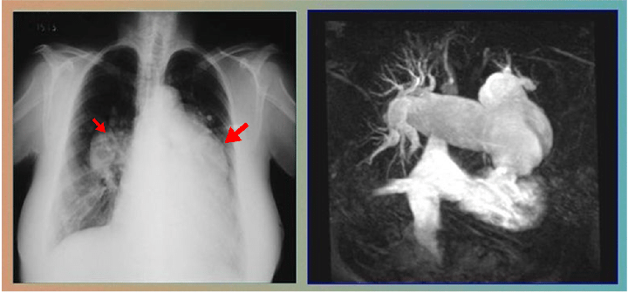
Schistosomiasis: Dilatation of left and right pulmonary arteries

Slide 15
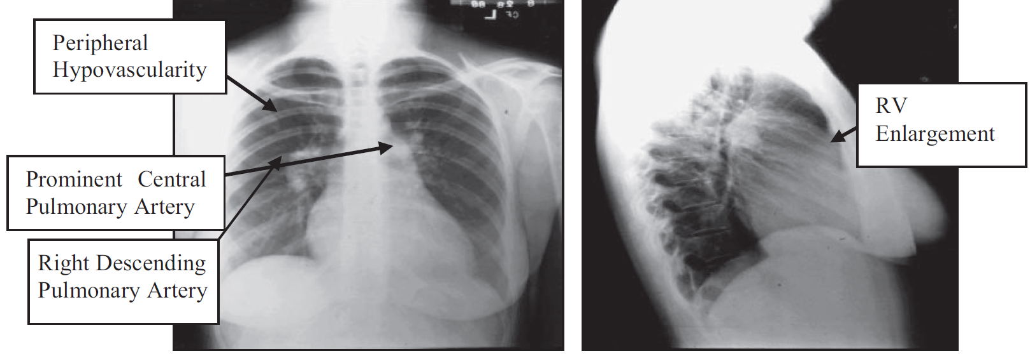

Slide 16
Enlarged pulmonary arterial “shadows”
Attenuation of peripheral pulmonary vascular markings →“Pruning”
Right ventricular enlargement
Clues to underlying etiology
  Interstitial lung fibrosis
  Pulmonary venous congestion → possible pulmonary veno-occlusive disease or pulmonary venous hypertension
  Hyperinflation → COPD
  Features suggesting pulmonary embolism

Slide 17
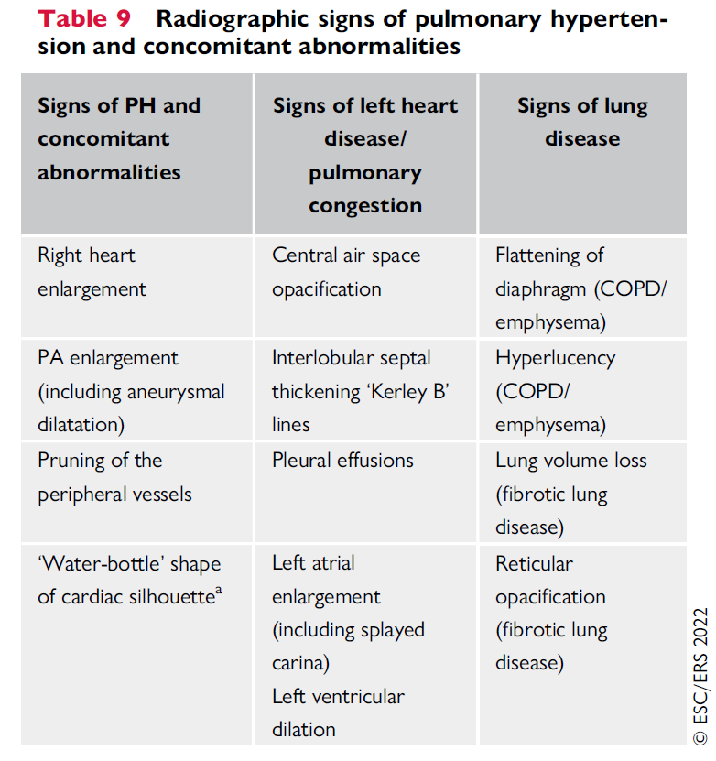

Slide 18
PFT and ABG
To distinguish between PH groups
PAH → PFTs are usually normal
Severe PFT abnormalities → PAH associated with CHD & group 3 PH
PAH → Normal or slightly reduced PaO2 + Lower than normal PaCO2
Severe reduction of PaO2 → R→ L shunts
Notes:
Due to alveolar hyperventilation

Slide 19
Echocardiography
Most important screening tool
RHC Vs. ECHO sensitivity of ≈ 90% and specificity of 70% in diagnosis of PH
Can assess
  Quantitate PA pressures
  LV systolic and diastolic dysfunction
  Valve function
  Congenital lesions
Notes:
Non-invasive widely available tool for diagnosis of PH

Slide 20
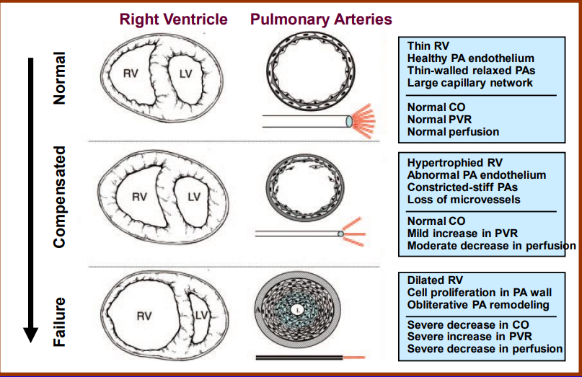
Ventricular remodelling- a result of chronic progressive pressure loading
Notes:
Right ventricular dilation also leads to tricuspid annular dilation and results in significant tricuspid regurgitation. When this is coupled with RV systolic dysfunction and increased afterload it will further reduce stroke volume into the pulmonary circulation and resultant reduced cardiac output. The additional volume loading as a consequence of tricuspid regurgitation will further impair RV diastolic function, increasing RV end-diastolic pressure and displacing the IVS.

Slide 21
Assessment of right heart
RV size
RV wall thickness
RV systolic function

Slide 22
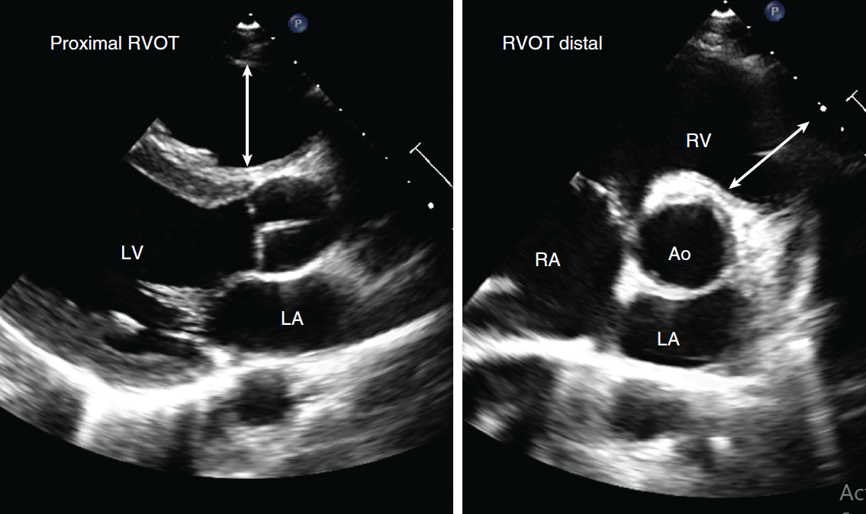
Notes:
Evaluation of RV size and systolic function is based on multiple views including the
parasternal long-axis (upper left) and short-axis . Standard measurements include the proximal and distal RV outflow tract
(RVOT at end-diastole

Slide 23
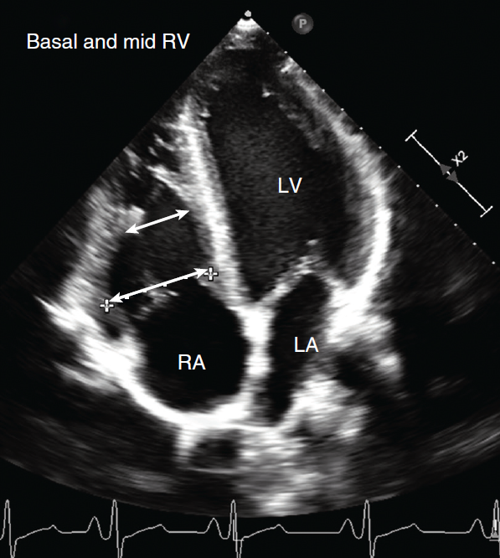
Notes:
Apical four-chamber view angulated to focus on the RV.

Slide 24
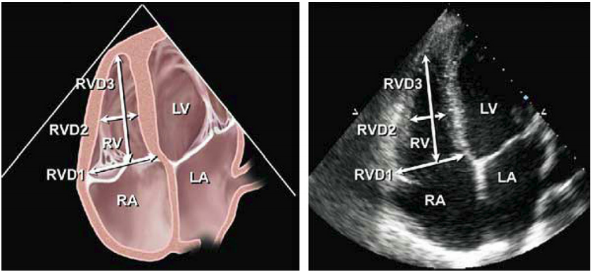
Level | Diameter
Base | >42 mm
Mid level | >35mm
Longitudinal | >86mm
Proximal RVOT | > 36 mm
Distal RVOT | > 28 mm
RV dilation
RV focused apical 4 chamber view
Notes:
Recommendations: Patients with echocardiographic evidence of right-sided heart disease or PH should ideally have measurements of RV basal, mid cavity, and longitudinal dimensions on a 4-chamber view. In all complete echocardiographic studies, the RV basal measurement should be reported, and the report should state the window from which the measurement was performed (ideally the right ventricle–focused view), to permit interstudy comparison

Slide 25
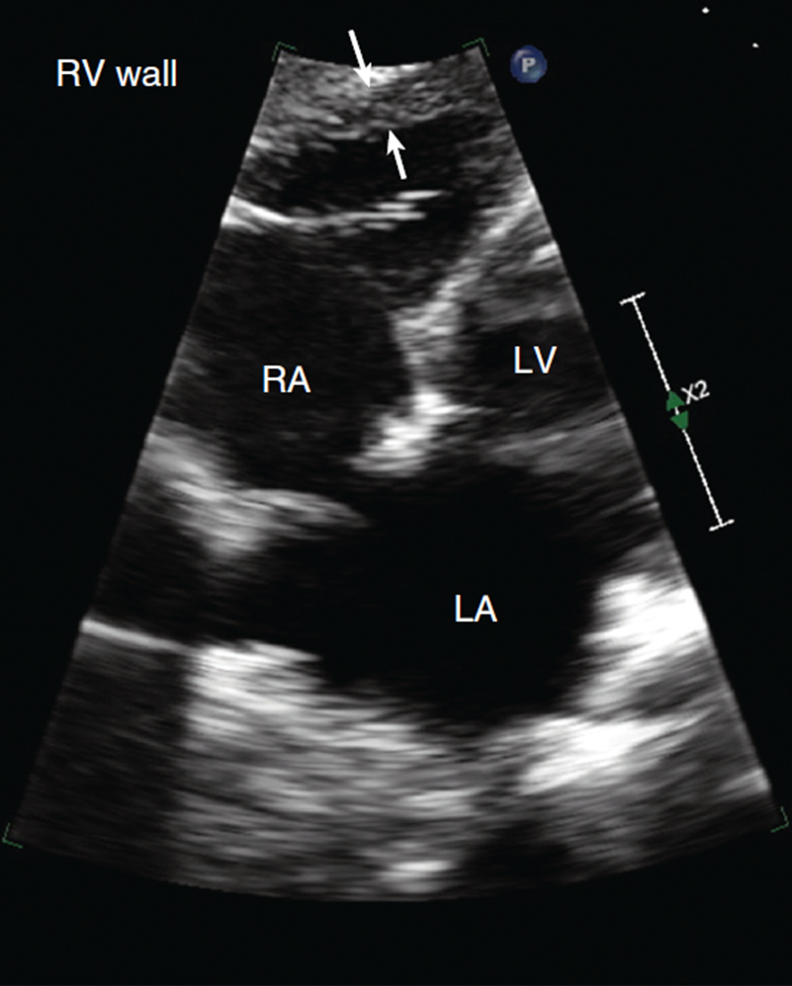
RV wall thickness
Linear measurement of RV free wall on subcostal view
Zoomed image at ED
At the level of tip of anterior tricuspid leaflet
Normal RV wall thickness 1–5 mm

Slide 26
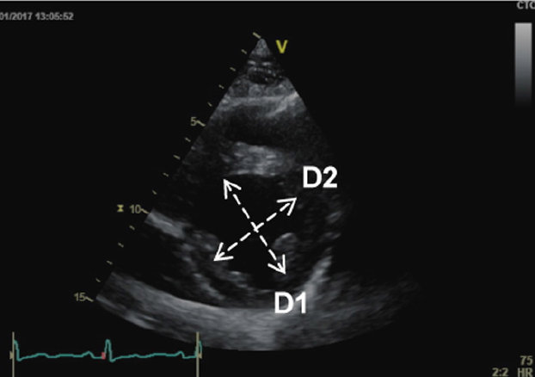
Eccentricity index
PSAX
Mid LV level
D2/D1
RV volume overload → Diastole only
RV pressure overload →Diastole & systole
> 1.1 → Abnormal
Notes:
Mid LV level between papillary muscle and tips of mitral valve leaflets. D1 = left ventricular diameter perpendicular to the septum; D2 = left ventricular diameter parallel to the septum. D2/D1

Slide 27
RV/LV basal diameter ratio
A4C
At end diastole
> 1 → Abnormal

Slide 28
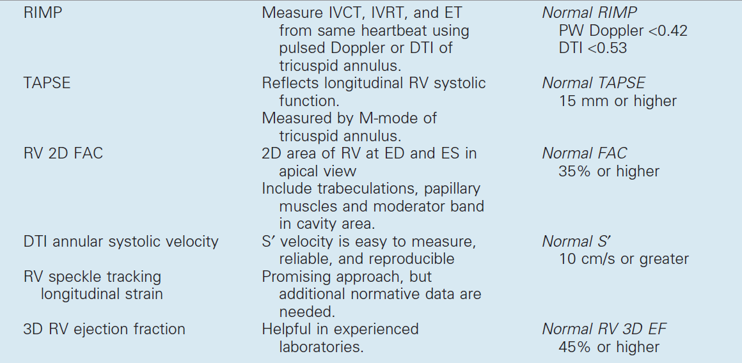
RV SYSTOLIC FUNCTION
Notes:
RIMP → RV index of myocardial performance. DTI → Doppler tissue imaging

Slide 29
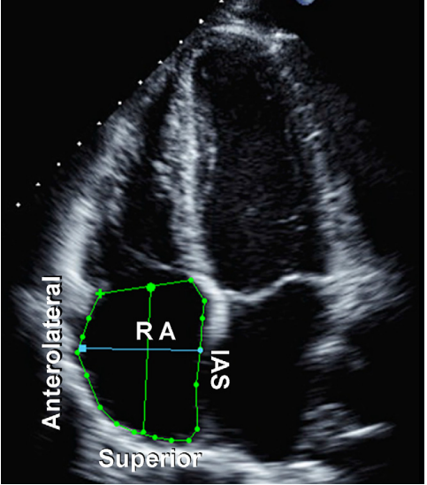
RA dilation
Estimated from A4C
Major axis dimension < 53 mm
Minor axis dimension < 44 mm
RA area (end- ventricular systole) < 18 cm²
Notes:
RA area is traced at the end of ventricular systole (largest volume) from the lateral aspect of the tricuspid annulus to the septal aspect, excluding the area between the leaflets and annulus, following the RA endocardium, excluding the IVC and superior vena cava and RA appendage (Figure 3).5 Note that RA dimensions can be distorted and falsely enlarged in patients with chest and thoracic spine deformities.
Because of the paucity of standardized RA volume data by 2D echocardiography, routine RA volume measurements are not currently recommended.

Slide 30
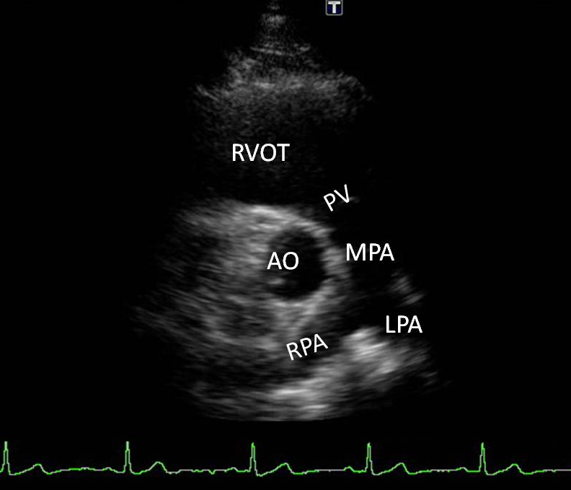
Pulmonary Vasculature
PSAX at PA bifurcation
Normal measurements
MPA → 1.5-2.1
RPA → 0.7-1.7
LPA → 0.6-1.4
> 25 mm → Abnormal
Assess PA and branches
Measure pulmonary annulus diameter, PA size

Slide 31
Pulmonary Systolic Pressure Estimates
Tricuspid Regurgitant Velocity
Pulmonic Regurgitant Velocity

Slide 32
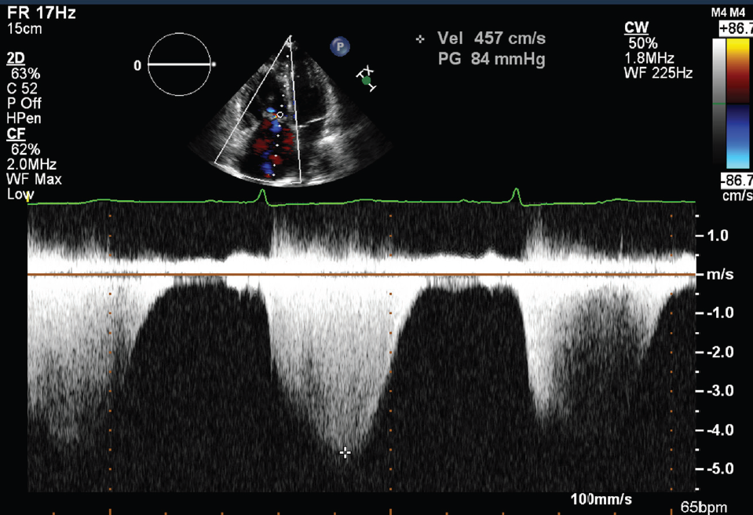
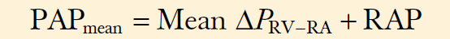
Tricuspid Regurgitant Velocity
Most reliable noninvasive method
∆P_{RV−RA} = 4(V_{TR} )²
RVP = PAPsystolic = 4(VTR )² + RAP
Requires presence of tricuspid regurgitation
Notes:
Rarely is a limitation because about 90% of normal individuals

Slide 33
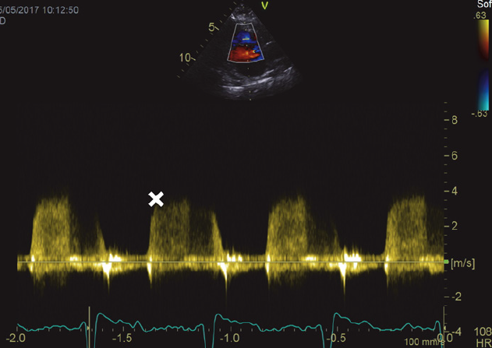
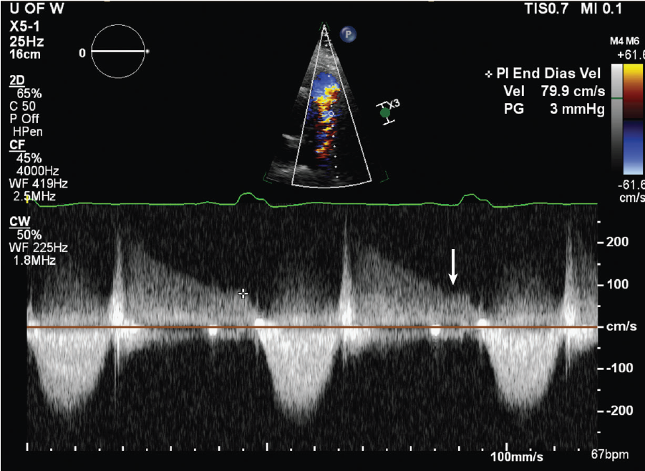
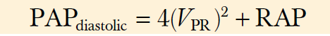
Pulmonic Regurgitant Velocity
Early PR velocity
> 2.2 m/s raised mean PAP
Notes:
Pulmonic regurgitation recorded from a parasternal approach with CW Doppler shows an end-diastolic velocity of about 1 m/s, indicating low diastolic pulmonary pressures.

Slide 34
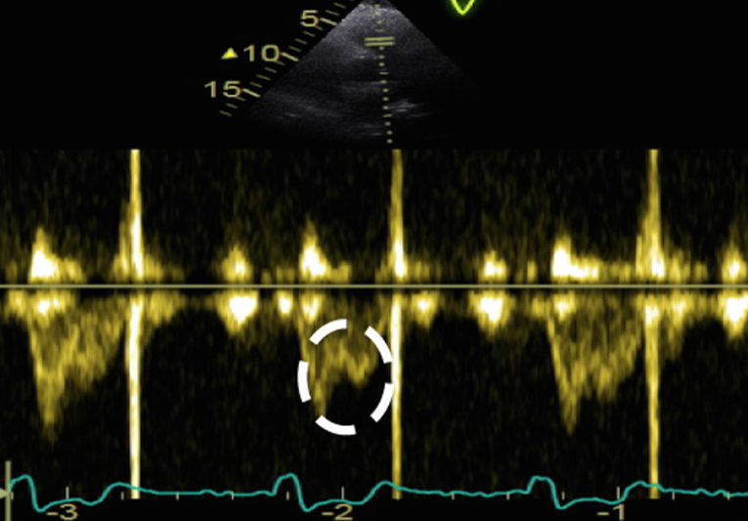
Pulmonary systolic notch
PSAX
Marker of raised PAP
↑PVR
Poor vascular compliance
Pre-capillary PH
Notes:
A PW Doppler measurement taken after positioning the sample volume just below the pulmonic cusp on the RV side in the RV outflow tract
Increased pulmonary vascular resistance and pulmonary arterial stiffness can cause a reflection of waves which return towards the RV during systole. This impedes RV ejection and causes ‘notching’ of the Doppler profile The presence of a pulmonary systolic notch is considered a marker of raised PAP The presence of a pulmonary mid systolic notch is more likely to represent increased pulmonary vascular resistance and poor vascular compliance in keeping with pre-capillary PH, rather than PH due to left heart disease

Slide 35
M-mode echocardiography
3 abnormalities of the pulmonary valve
Absent or diminished ‘a’ wave
Mid-systolic notching
Increased right ventricular pre-ejection period to ejection time (RVPEP/RVET) ratio

Slide 36
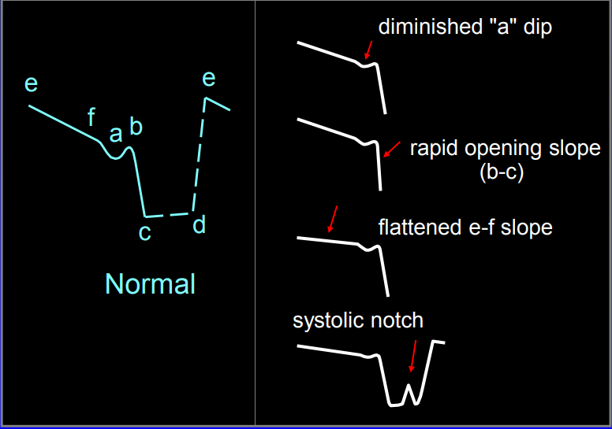
‘a’ – depth of the posterior deflection of pulmonary valve immediately following atrial contraction; correlates with the peak pressure gradient across pulmonary valve; normally measures 2-7mm
Notes:
Normally there is a minimal difference between the RVEDP & PAEDP. Therefore a small increase in RVEDP will be transmitted to the PV resulting a deflection. In PH, the increase in PAEDP is much greater than RVEDP.

Slide 37
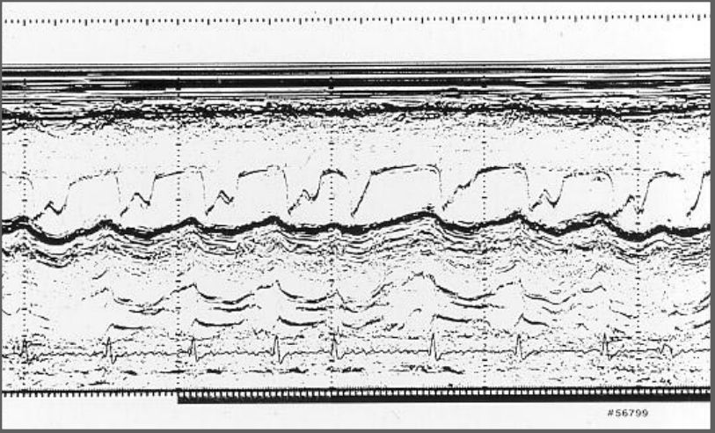
‘W’ shaped pattern

Slide 38
Pulmonary Vascular Resistance
Pulmonary Artery Velocity Curve
Pulmonary Vascular Resistance Calculations
Notes:
Pulmonary pressure is not an ideal measure of the vascular properties of the pulmonary bed because pressure is affected by volume flow rate (increased pressures with higher flow rates and vice versa) and by the LA pressure

Slide 39
Pulmonary Artery Velocity Curve
Findings suggesting that the shapes of these velocity curves
  Downstream resistance or impedance
Notes:
LV ejection curves show very rapid acceleration with a short time from flow onset to maximum velocity, whereas RV ejection curves show slower acceleration, a longer time from onset of flow to peak flow, and a more “rounded” velocity curve. As pulmonary vascular resistance increases, the shape of the RV ejection curve more closely approximates an LV

Slide 40
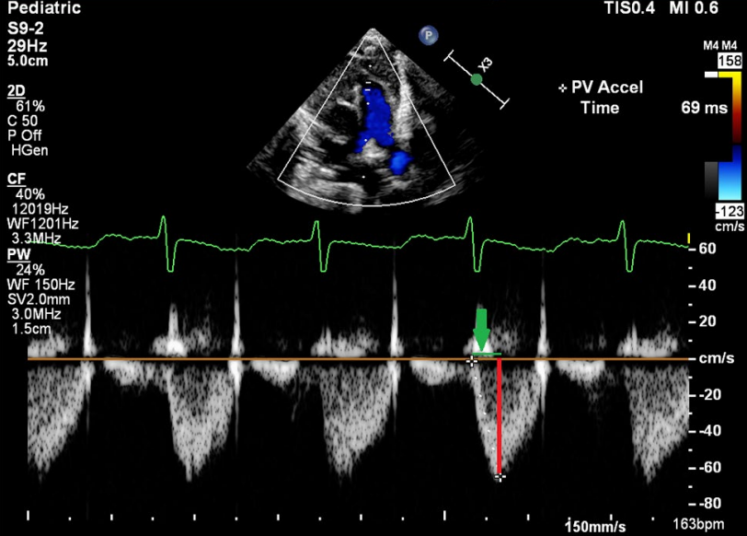
< 105 ms → Marker of raised PAP
Notes:
Shows the Doppler cursor placed in the center of the pulmonary valve just proximal to the annulus with perfect alignment with the main pulmonary artery axis obtained from the parasternal short axis view. PAAT (the green line that depicted by the green arrow) is defned by the time between the onset of right ventricle ejection and peak fow velocity.

Slide 41
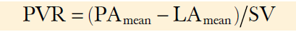
Pulmonary Vascular Resistance
Pressure drop across the pulmonary bed (MSAP – MLAP)
Stroke volume (SV)
Normal is < 1.5 Wood units
< 120 dynes/s/cm-5
Notes:
Noninvasive calculation of pulmonary resistance is problematic because of difficulty in measuring mean LA pressure and because of the measurement variability in noninvasive pulmonary artery pressure and right heart cardiac output calculations

Slide 42
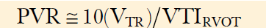
Estimate the pressure drop across the pulmonary bed using
Peak tricuspid regurgitant jet velocity (VTR in m/s) (ignoring LA pressure)
Estimate stroke volume using
Velocity-time integral of flow in the RV outflow tract (VTI_{RVOT} in cm)
Ratio is multiplied by 10 to approximate PVR in Wood units

Slide 43
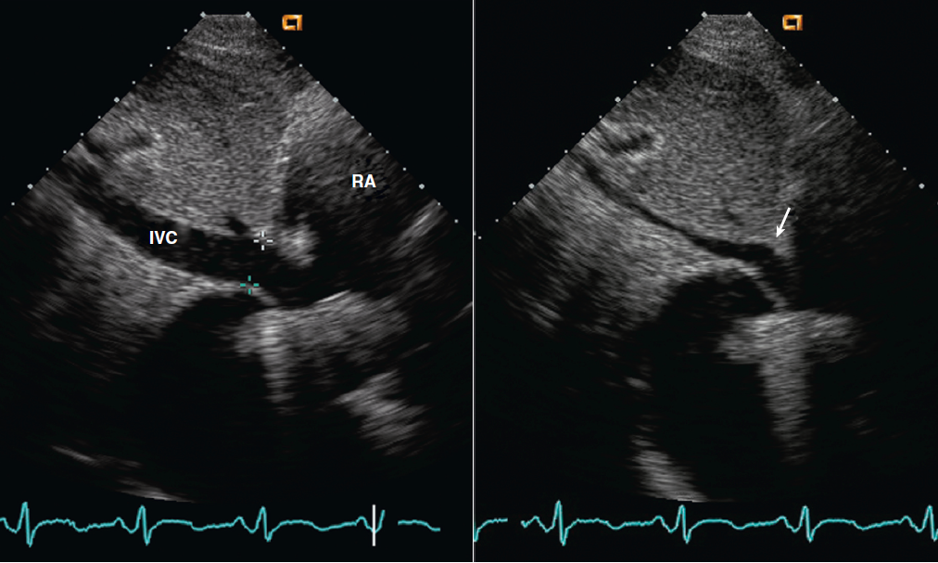
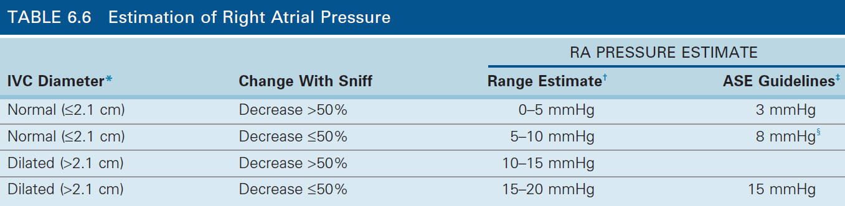
Estimation of Right Atrial Pressure
Estimated from inferior vena cava during respiration
Subcostal window

Slide 44
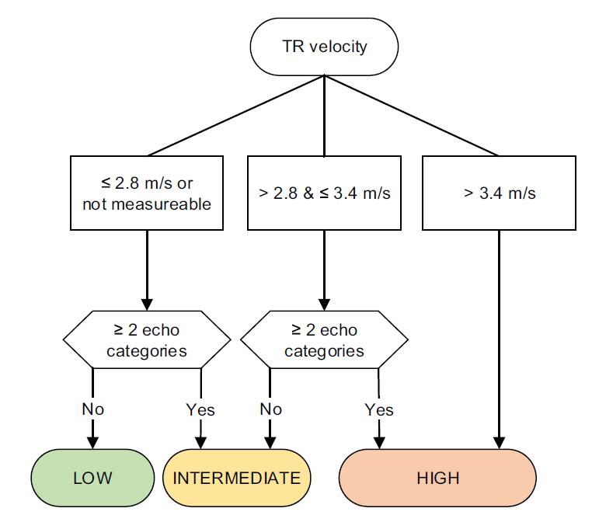
Notes:
Echocardiographic probability of pulmonary hypertension and recommendations for further assessment

Slide 45
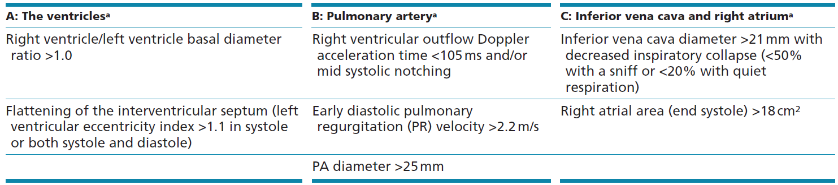
Notes:
Echocardiographic parameters from at least two different categories (A/B/C) from the list should be present to alter the level of echocardiographic probability of pulmonary hypertension.

Slide 46
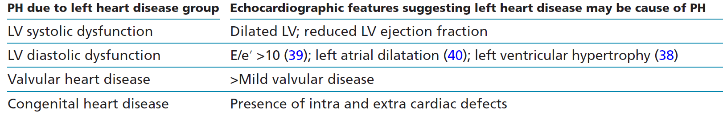
Features which may suggest left heart disease causing PH

Slide 47
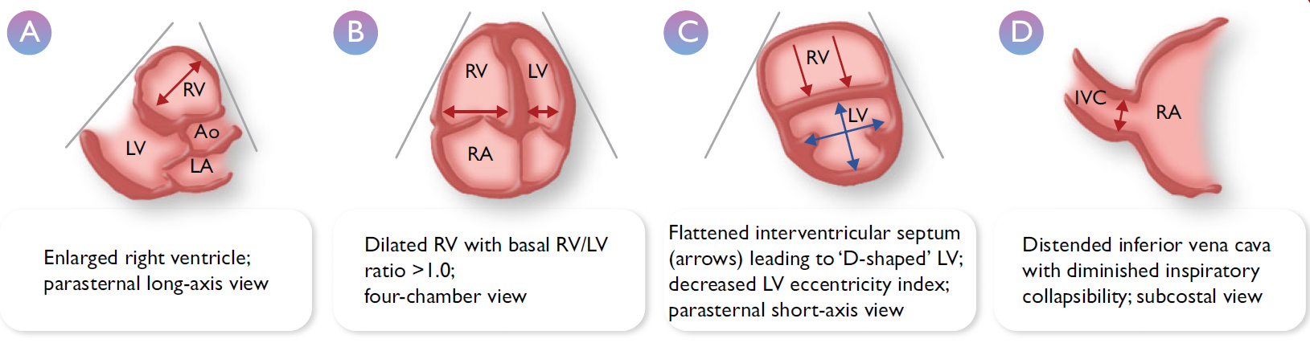

Slide 48
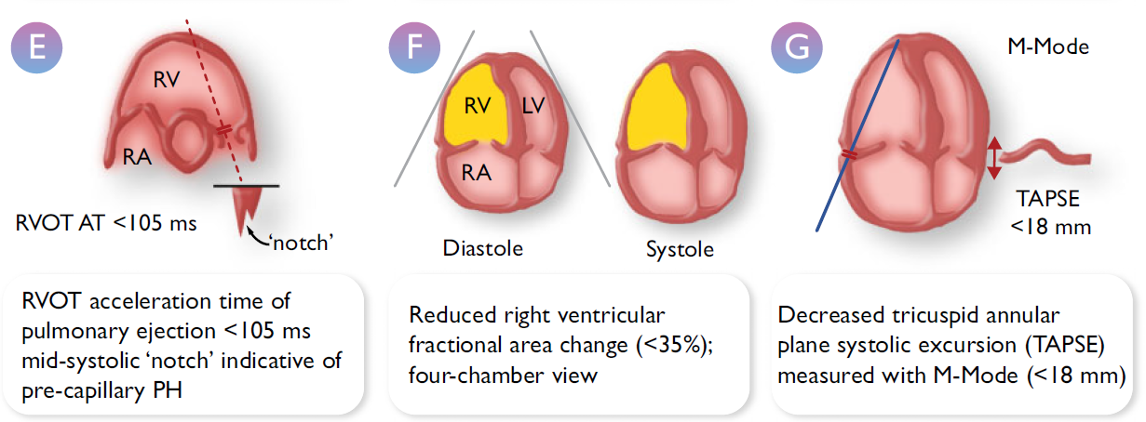

Slide 49
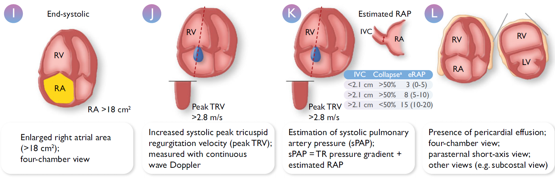

Slide 50
NCCT / CECT Thorax
PA diameter ≥ 30 mm
RVOT wall thickness ≥6 mm
Septal deviation ≥ 140° or RV:LV ratio ≥ 1
Parenchymal lung disease
Highly predictive of PH

Slide 51
CTPA
To detect direct or indirect signs of CTEPH
Sensitivity :76%
Specificity : 96%
Detect other CVS abnormalities
  Intracardiac shunts
  Abnormal pulmonary venous return
  Patent ductus arteriosus
  PAVMs

Slide 52
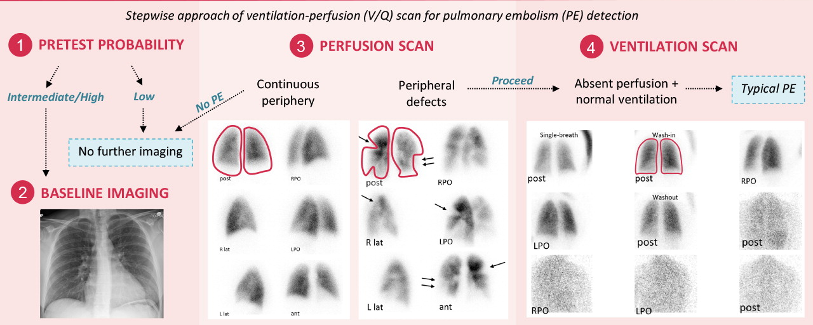
Ventilation/perfusion lung scan
To rule out or detect signs of CTEPH
NPV = 98%
Deposition of the perfusion agent in extra-pulmonary organs
  Cardiac or pulmonary right-to-left shunting
  CHD
  Hepatopulmonary syndrome
  PAVMs
Notes:
recommended in the diagnostic work-up of patients with suspected or newly diagnosed PH, to rule out or detect signs of CTEPH. PAH, V/Q
scintigraphy is normal or shows a speckled pattern but no typical perfusion defects.

Slide 53
Cardiac MRI
Atrial and ventricular size & function
Measure blood flow in the PA, aorta and vena cava
Intracardiac shunt
Quantify SV

Slide 54
Blood tests and immunology
CBC
RFT
SE
LFT
TSH
Iron studies
Serology screening
ANA
Anti-centromere antibodies
Anti-Ro antibodies
APLA workup (CTEPH)

Slide 55
Abdominal ultrasound
Search for
  Liver disease
  Portal hypertension
  Portocaval shunt (Abernethy malformation)

Slide 56
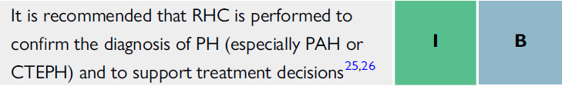
Right heart catheterization
Gold standard
Additional roles
  Hemodynamic assessment of heart or LTx candidates
  Evaluating congenital cardiac shunts
Notes:
Gold standard for diagnosing and classifying PH

Slide 57
Complete study includes…
Oxyhemoglobin saturation (SaO2) analysis in different vascular compartments
Intravascular and intra-cardiac pressure measurement
CO assessment
PAWP measurement

Slide 58
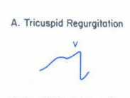
Right Atrial Pressure
Attenuated x descent
Prominent c-v wave
Deep and rapid y descent
Presence of RV hypertrophy
Pressure overload
Owing to RV noncompliance
TR
Prominent “a” wave

Slide 59
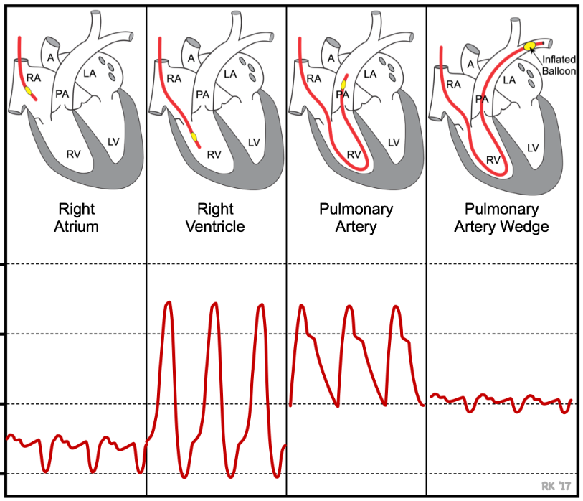
Pulmonary Artery and Pulmonary Capillary Wedge Pressures
Notes:
PCWP is measured by inserting balloon-tipped, multi-lumen catheter (Swan-Ganz catheter) into a peripheral vein (e.g., jugular or femoral vein), then advancing the catheter into the right atrium, right ventricle, pulmonary artery, and then into a branch of the pulmonary artery. The catheter has a lumen (port) that opens at the tip of the catheter distal to the balloon. This port is connected to a pressure transducer. As illustrated below, the location of the catheter can be determined by viewing the pressure measured from the tip of the catheter. In the right atrium (RA), the pressure usually averages <5 mmHg and fluctuates a few mmHg. When the catheter is advanced into the right ventricle (RV), the systolic pressure increases to ~25 mmHg and the diastolic pressure remains similar to right atrial diastolic pressure. When the catheter enters the pulmonary artery (PA), the systolic pressure normally is similar to the right ventricular systolic pressure, but the diastolic pressure increases to about 10 mmHg because of pulmonic valve closure at the beginning of diastole. Just behind the tip of the catheter is a small balloon that can be inflated with air (~1 cc). When properly positioned in a branch of the pulmonary artery, the distal port measures pulmonary artery pressure (~ 25/10 mmHg; systolic/diastolic pressure). The balloon is then inflated, which occludes the branch of the pulmonary artery. When this occurs, the pressure in the distal port rapidly falls, and after several seconds, reaches a stable lower value that is very similar to left atrial pressure (mean pressure normally 8-10 mmHg). The pressure recorded during balloon inflation approximates left atrial pressure because the occluded vessel and its distal branches that eventually form the pulmonary veins act as an extension of the catheter

Slide 61
Pulmonary Vascular Resistance
Mean PAP – PAWP
CO

Slide 62
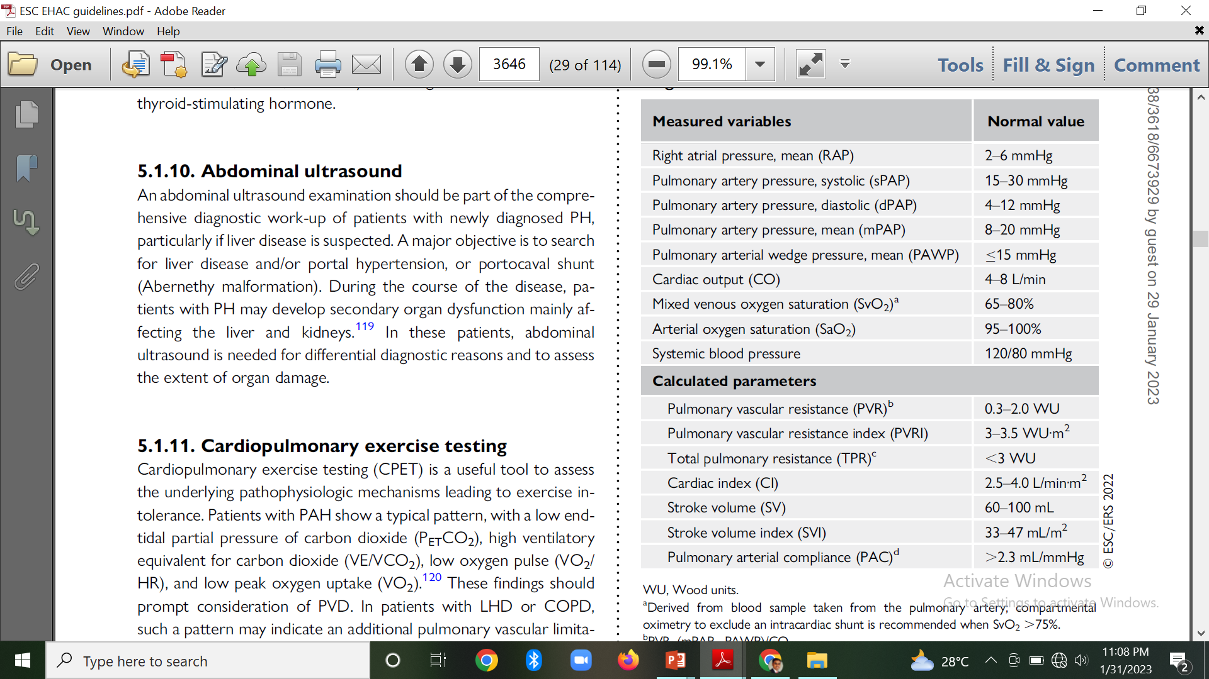

Slide 63
Vasoreactivity testing
Idiopathic, hereditary, and drug/toxic-associated PAH
Inhaled NO, inhaled iloprost, i.v. epoprostenol
Decrease in mPAP ≥10 mm Hg to reach an mPAP ≤40 mm Hg
Increase or no change in CO
I.V ADENOSINE
Notes:
purpose of vasoreactivity testing in PAH is to identify acute vasoresponders who may be candidates for treatment with CCBs. Pulmonary vasoreactivity testing is only recommended in patients with IPAH, HPAH, or DPAH. Inhaled nitric oxide or inhaled iloprost are the recommended test compounds for vasoreactivity testing. There is similar evidence for intravenous (i.v.) epoprostenol. Adenosine i.v. is no longer recommended due to frequent side effects. A positive acute response is defined as a reduction in mPAP by ≥10 mmHg to reach an absolute value ≤40 mmHg, with increased or unchanged CO.

Slide 64
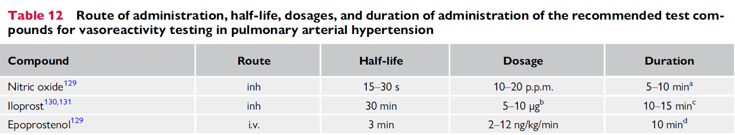

Slide 65
Fluid challenge
PAH Vs. PH-left heart disease
500 mL normal saline over 5 min
Occult LV lusitropic impairment to uncover PH
↑PAWP to > 18 mm Hg
Most available data are derived from studies aiming to uncover HFpEF rather than identify group 2 PH
Notes:
Differentiating PAH from PH-left heart disease may be challenging, especially in patients with borderline abnormal PAWP (13 to 15 mmHg), risk factors for HFpEF, and/or on diuretic therapy.

Slide 66
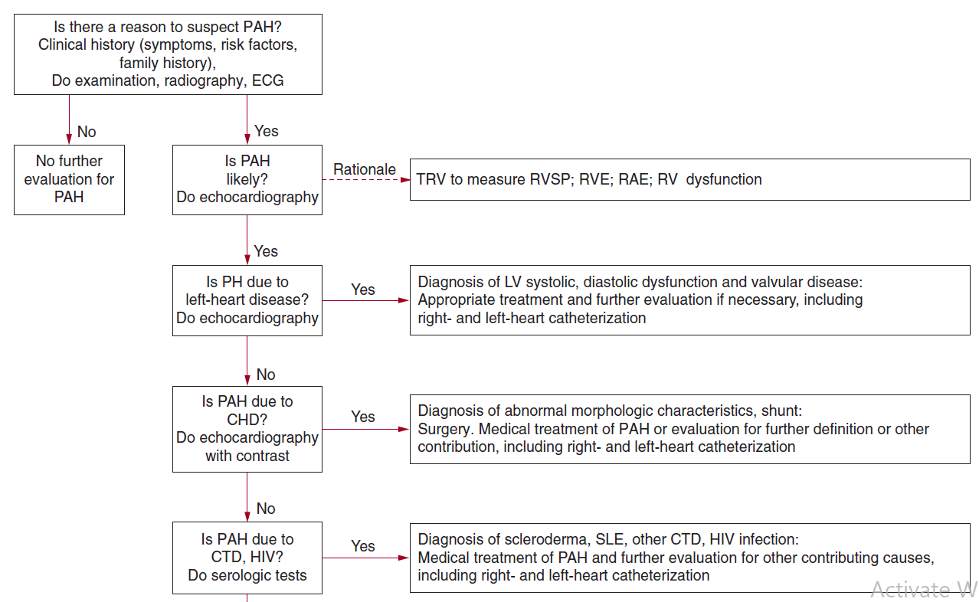

Slide 67
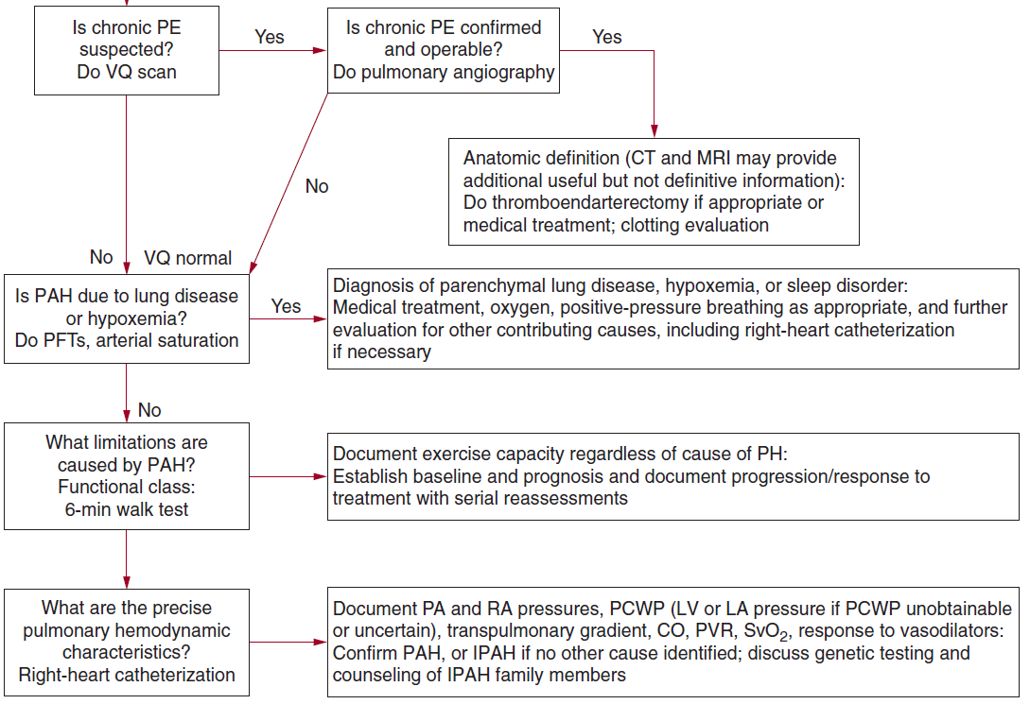

Slide 68
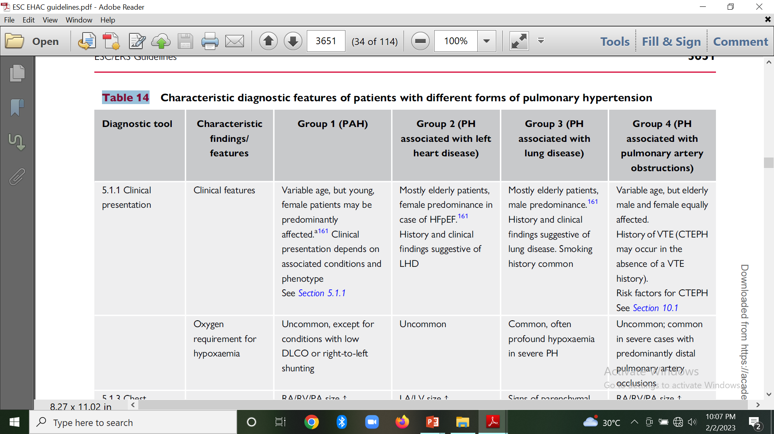

Slide 69
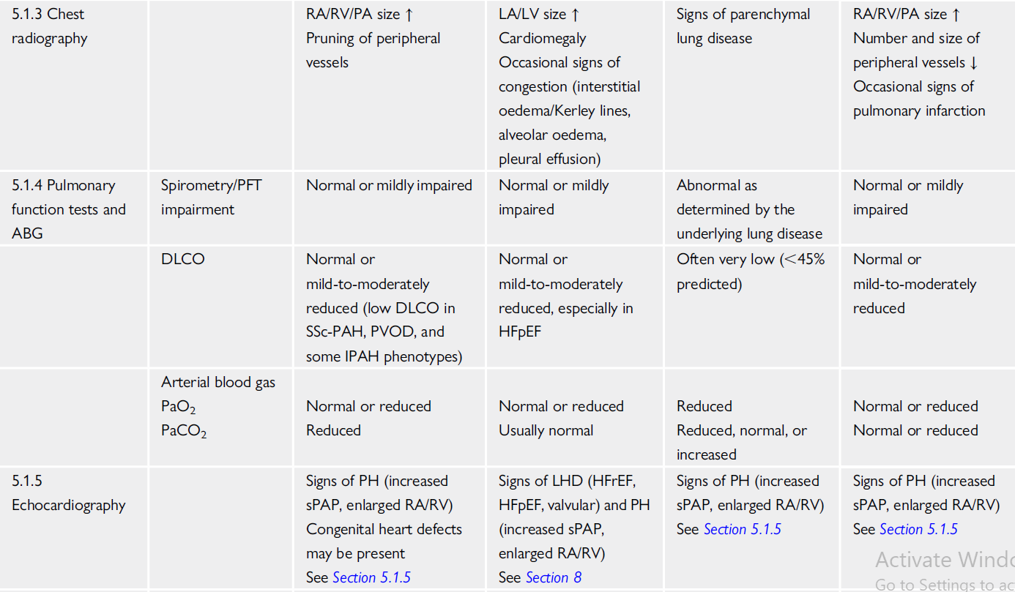

Slide 70
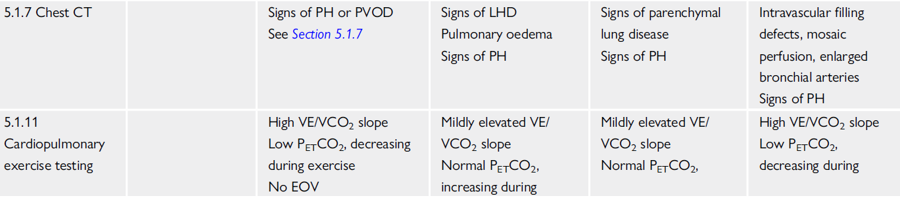


Slide 71
Treatment

Slide 72

Pulmonary arterial hypertension (group 1)

Slide 73


Slide 74
General measures
Physical activity and supervised rehabilitation
Anticoagulation
Diuretics
Oxygen
Anaemia and iron status

Slide 75

Pulmonary arterial hypertension therapies

Slide 76


Slide 77


1. Calcium channel blockers
Systemic hypotension
Peripheral oedema
Notes:
Patients with PAH who respond favourably to acute vasoreactivity testing (Figure 8) may respond favourably to treatment with CCBs. Less than 10% of patients with IPAH, HPAH, or DPAH are responders, while an acute vasodilator response does not predict a favourable long-term response to CCBs in patients with other forms of PAH.

Slide 78
Not undergone a vasoreactivity study
Negative test
Potentially severe side effects (e.g. severe hypotension, syncope, and RV failure)
CCB

Slide 79

2. Endothelin receptor antagonists

Slide 80
Ambrisentan
Oral ERA
Preferentially blocks the endothelin A receptors
Peripheral oedema
Notes:
In patients with PAH, it has demonstrated efficacy for symptoms, exercise capacity, haemodynamics, and time to clinical worsening

Slide 81
Bosentan
Oral
Dual ERA
Dose-dependent increases in liver transaminases → Monthly LFT
Pharmacokinetic interactions
  Hormonal contraceptives unreliable
  Lower serum levels of warfarin, sildenafil and tadalafil
Notes:
Improves exercise capacity, WHO-FC, hemodynamics, and time to clinical worsening in patients with PAH. LFT derangement in10% of treated patients → reversible after dose reduction or discontinuation.

Slide 82
Macitentan
Oral
Dual ERA
No liver toxicity
↓Hb to ≤8 g/dL
Notes:
increase exercise capacity and reduce a composite endpoint of clinical worsening in patients with PAH

Slide 83

3. Phosphodiesterase 5 inhibitors and guanylate cyclase stimulators
Vasodilation (headache, flushing, and epistaxis)
Notes:
With or without background therapy) have confirmed favourable results on exercise capacity, symptoms, and/or haemodynamics

Slide 84

Notes:
While PDE5is augment the nitric oxide–cGMP pathway by slowing campy degradation, sags stimulators enhance cGMP production by directly stimulating the enzyme, both in the presence and absence of endogenous nitric oxide. favourable results on exercise capacity, haemodynamics, WHO-FC, and time to clinical worsening. The side effect profile was similar to that of PDE5is.

Slide 85
Prostacyclin analogues and prostacyclin receptor agonists
Epoprostenol | Iloprost | Treprostinil | Beraprost | Selexipag
Short half-life 3-5 mins | Inhaled route | s.c., i.v., inhaled, oral | Stable and orally active | Orally available, selective
Continuous i.v. | Increase in exercise capacity | Improved exercise capacity,
IPAH Other associated PAH conditions | Improvement in symptoms, PVR, and clinical events | Hemodynamics, and symptoms in PAH
Local site infection Catheter obstruction Sepsis |  | Infusion-site pain |  | Headache Diarrhoea Nausea Jaw pain
Notes:
The prostacyclin metabolic pathway is dysregulated in patients with PAH, with less prostacyclin synthase expressed in PAs and reduced prostacyclin urinary metabolites. Prostacyclin analogues and prostacyclin receptor agonists induce potent vasodilation, inhibit platelet aggregation, and also have both cytoprotective and anti-proliferative activities

Slide 86
So recommendations…
Initial combination therapy with an ERA and a PDE5i
AMBITION study
  Initial combination therapy (Ambrisentan 10 mg OD + Tadalafil of 40 mg OD)
  Monotherapy (Either drug)
Vs.
Significant improvements in
  6MWD
  NT-pro BNP
Initial combination therapy

Slide 87
TRITON study
Initial dual-combination therapy
  Macitentan + Tadalafil
Initial triple-combination therapy
  Macitentan 10 mg OD
  Tadalafil 40 mg OD
  Selexipag 1600 μg OD
Vs.
No benefit of oral triple Vs. oral double-combination therapy

Slide 88
Newly diagnosed patients
Low or intermediate risk
  Initial dual-combination therapy → ERA + PDE5i
High risk
  Initial triple combination therapy → ERA + PDE5i + i.v./s.c. prostacyclin analogue

Slide 90
Interventional therapy
Balloon atrial septostomy
Potts shunt
Pulmonary artery denervation

Slide 91


Balloon atrial septostomy and Potts shunt
Notes:
Balloon atrial septostomy by creating an interatrial shunt, and Potts shunt, by connecting the left PA and descending aorta, aim to decompress the right heart and increase systemic blood flow, thereby improving systemic oxygen transport despite arterial oxygen desaturation. As these procedures are complex and associated with high risk, including substantial procedure-related mortality, they are rarely performed in patients with PAH and may only be considered in centres with experience in the techniques.

Slide 92
Pulmonary artery denervation
PADN with Intravascular ultrasound catheter
Principle
↑ sympathetic overdrive characterizing PAH → Poor outcome
Vasoconstriction and vascular remodeling → Baroreflex mediated
Stretch receptors located at the bifurcation of the Pas
Applying radiofrequency
Little evidence yet from multicenter RCTs

Slide 93


Slide 94
Advanced right ventricular failure
Intensive care unit management
Mechanical circulatory support
  Veno-arterial ECMO → Most widely used approach
  Bridging tool to transplantation

Slide 95
Lung and heart–lung transplantation
PAH refractory to optimized medical therapy
Most patients → Receive bilateral LTx
Combined heart–lung transplantation → Additional non-correctable cardiac conditions

Slide 96


Slide 97



Slide 98
New drugs (phase 3 studies)
RALINEPAG
  Oral
  Potent
  Selective prostacyclin receptor agonist
SOTATERCEPT
  Fusion protein
  Acts as a ligand trap for members of the TGF-β superfamily
  Restoring balance between growth promoting and growth-inhibiting pathways
Improved PVR
Improved
PVR, 6MWD and NT-pro BNP

Slide 99

Pulmonary arterial hypertension associated with drugs and toxins

Slide 100


Slide 101


Pulmonary arterial hypertension associated with adult congenital heart disease
Limited data on the use of drugs
Bosentan
Supplemental oxygen therapy
Supplemental iron
Notes:
limited data exist on the use of drugs approved for PAH in patients with adultCHD-associated PAH.

Slide 102


Slide 103


Slide 104


Slide 105
Pulmonary hypertension associated with left heart disease
HFrEF or HFmrEF
  GDMT
  Advanced HFrEF →LVAD
  Sildenafil→ Small studies - may improve hemodynamics and exercise capacity
  RCTs are lacking

Slide 106

HFpEF
Control BP and risk factors
Empagliflozin improved outcomes (LVEF = 40–60%)

Slide 107
Pulmonary hypertension associated with lung diseases and/ or hypoxia
Notes:
There is limited and conflicting evidence for the use ofmedication approved for PAHin patients with group 3 PH, and these drugs may have variable and sometimes detrimental effects on haemodynamics, exercise capacity, gas exchange and outcomes in this patient population

Slide 108
Pulmonary hypertension associated with chronic obstructive pulmonary disease
COPD and severe PH
PDE5i → Improved
  WHO-FC
  6MWD
  PVR
  Transplant-free survival
Lack of RCT → Insufficient data

Slide 109

Pulmonary hypertension associated with ILD
Promising results → Inhaled treprostinil
Lung Transplantation
Phase 3 RCT (INCREASE)
6MWD
NT pro BNP
Sildenafil
Ambrisentan
Riociguat

Slide 110

Chronic thromboembolic pulmonary hypertension
Multimodal approach
Notes:
PEA 10–40 mm PEA and BPA interventions (vessel diameter 2–10 mm) BPA interventions (vessel diameter 0.5–5 mm) Microvasculopathy (vessel diameter ,0.05 mm) treated with medical therapy

Slide 111


Slide 112

Medical therapy

Slide 113
Pulmonary hypertension with unclear and/or multifactorial mechanisms

Slide 114



Slide 115
Pulmonary Hypertension Registry of Kerala, India
(PRO-KERALA): One-year outcomes
Indian Heart Journal 74 (2022)
PRO-KERALA registry → Largest PH registry from the Asian subcontinent
M.C etiology → Group II PH >>> Group I PH
Primary endpoint → All cause death / hospitalization → 9.1%
Rates of adverse outcomes → Considerably lower in comparison to the contemporary Western PH registries

Slide 116

Notes:
LD-PH → Lung disease associated pulmonary hypertension DC → Dual combination drugs

Slide 117
Only 31% of eligible PH patients were on specific vasodilator therapy
Study calls for →
  Quality improvement programmes
  To improve guideline directed therapy rates and clinical outcomes

